Slide 1
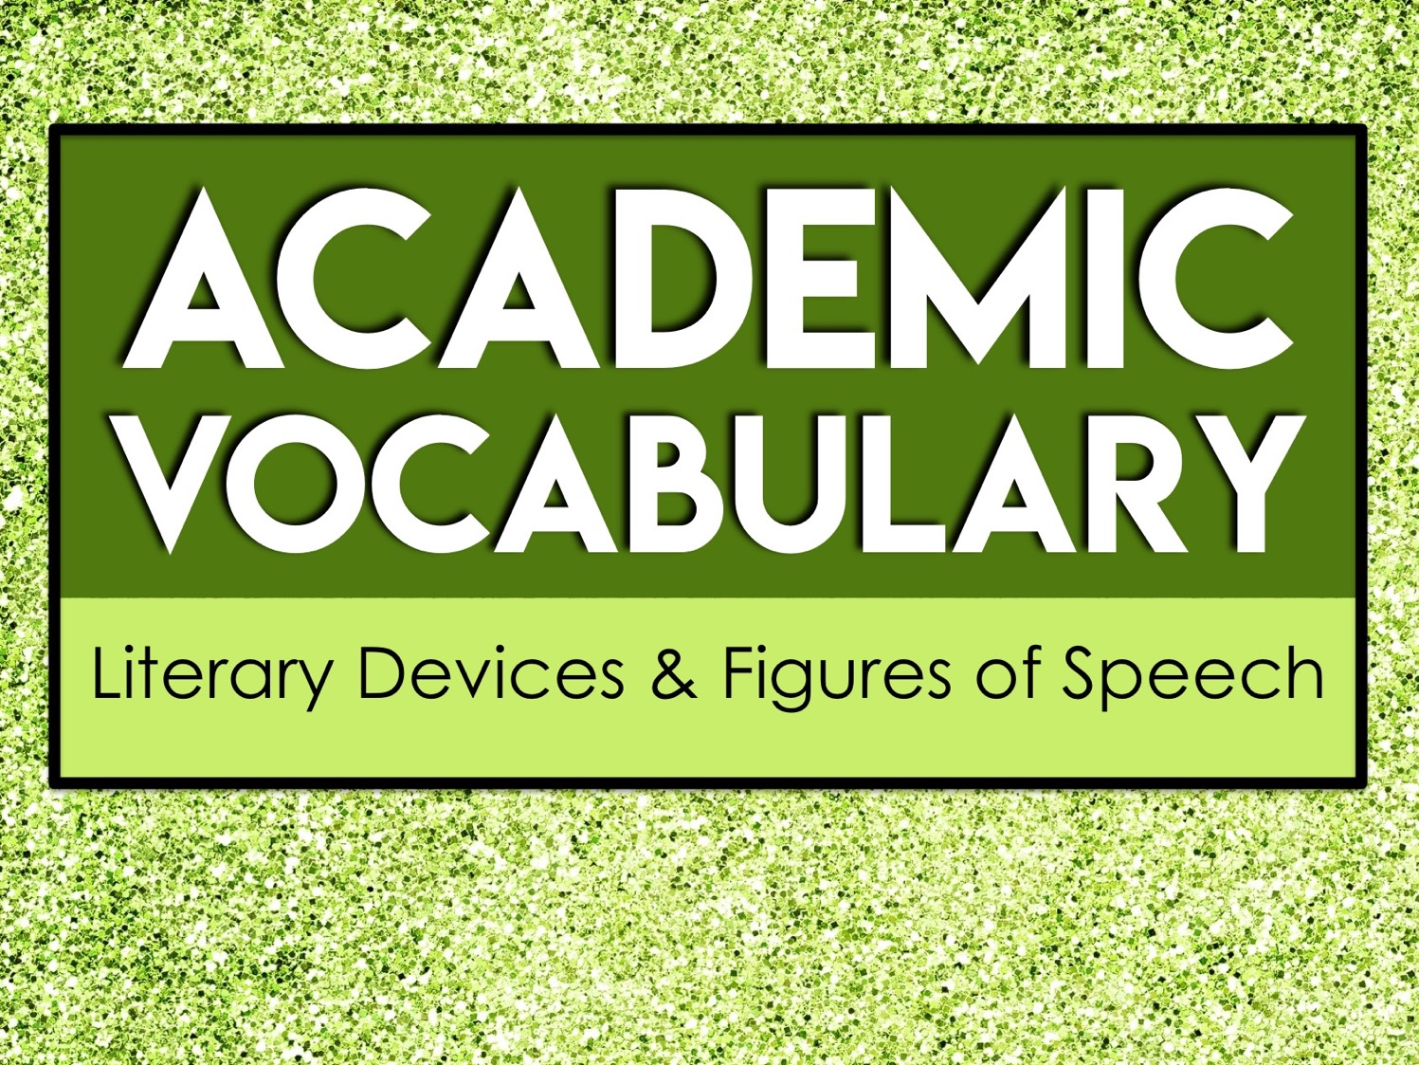
Academic
Vocabulary
Literary Devices & Figures of Speech

Slide 2
About Academic Vocabulary
Academic vocabulary refers to words that you will likely encounter in an academic setting.
Academic vocabulary shows up in text books, standardized tests, and in instructions for school assignments.
The more academic vocabulary you know, the more likely you are to be successful in school!

Slide 3
Focus on Five at a Time
We will learn 25 new academic vocabulary terms during this unit.
However, we will only focus on five words at a time.
Each week we will have five new words to learn.

Slide 4
Our Week in Academic Vocabulary
Monday: Introduce the words.
Tuesday: Draw it out.
Wednesday: Word Web Wednesday!
Thursday: Reflect about the words.
Friday: Quiz time!
End of the unit: We will review ALL 25 of the academic words you’ve learned.

Slide 5
Monday
On Mondays, we will take a quick pretest on five new vocabulary words.
Then, we will go over each word.
You’ll write the words and their definitions on your weekly handout.

Slide 6
Tuesday
On Tuesdays, we will take a few minutes to review the words.
During this time, you’ll draw a quick visual representation for each word.
The drawings do not need to be perfect. Anything that helps you associate the word to the definition will help you!

Slide 7
Wednesday
On Wednesdays, we will take a few minutes to review the words.
During this time, you’ll create a word web for each word.
A word web is a graphic representation containing words. You’ll write words that have similar meanings and words that are associated with the vocabulary term on your paper.

Slide 8
Word Web Example
language
list
vocabulary
terms
words

Slide 9
Thursday
On Thursdays, we will take a few minutes to review the words.
During this time, you’ll look over all of the work from the week and write a brief reflection about what you learned.
Your reflection should be at least three sentences long and contain some of the vocabulary words.

Slide 10
Reflect/Journal
Your vocabulary journal/reflection should be at least three sentences long. You can use these questions to help get you started.
What did you learn about the words?
What word did you not know prior to this week?
How do these words relate to one another?
How will knowing these words help you succeed in an academic setting?

Slide 11
Friday
On Fridays, we will take a quick test on five vocabulary words from the week.
After the test, you’ll record your score and write down the words you still need to study.
As we continue with new words, make sure you go back and revisit the words you still need to learn.

Slide 12
Academic
Vocabulary
Literary Devices & Figures of Speech

Slide 13
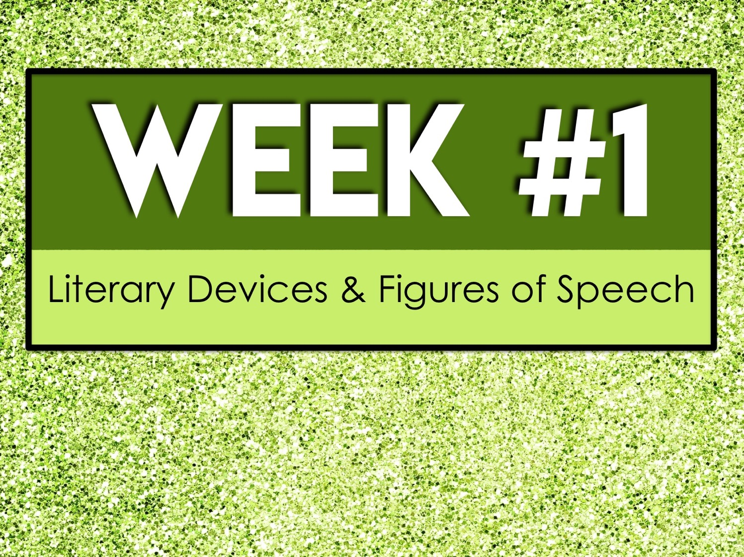
Week #1
Literary Devices & Figures of Speech

Slide 14
Week #1 Words
Allegory
Alliteration
Allusion
Analogy
Anecdote

Slide 15
Week #1 Pretest
DIRECTIONS: In your own words, try your best to define each term.
Allegory
Alliteration
Allusion
Analogy
Anecdote

Slide 16
Allegory
a story, poem, or picture that can be interpreted to reveal a hidden meaning, typically a moral or political one

Slide 17
Alliteration
the repetition of the same letter or sound at the beginning of adjacent or closely connected words

Slide 18
Allusion
a brief and indirect reference to a person, place, thing or idea of historical, cultural, literary or political significance

Slide 19
Analogy
a comparison between two things, typically on the basis of their structure and for the purpose of explanation or clarification

Slide 20
Anecdote
a short and amusing or interesting story about a real incident or person

Slide 21
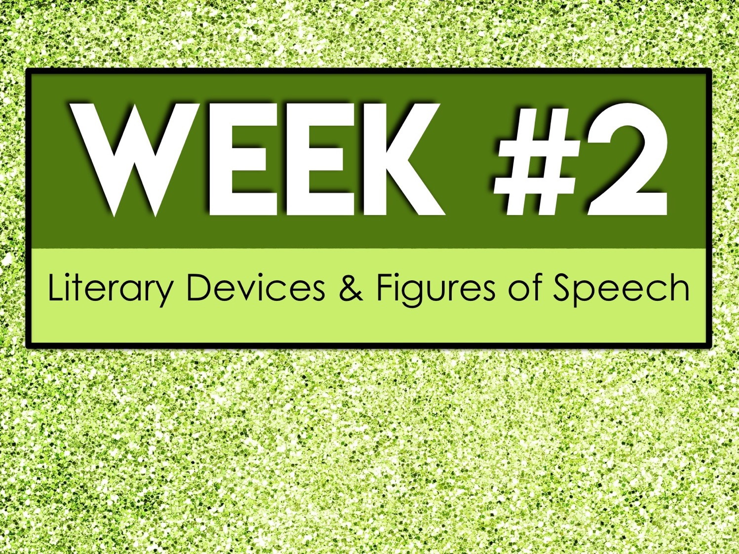
Week #2
Literary Devices & Figures of Speech

Slide 22
Week #2 Words
Anthropomorphism
Epithet
Euphemism
Figurative language
Foreshadowing

Slide 23
Week #2 Pretest
DIRECTIONS: In your own words, try your best to define each term.
Anthropomorphism
Epithet
Euphemism
Figurative language
Foreshadowing

Slide 24
Anthropomorphism
the attribution of human characteristics or behavior to a god, animal, or object

Slide 25
Epithet
an adjective or descriptive phrase expressing a quality characteristic of the person or thing mentioned

Slide 26
Euphemism
a mild or indirect word or expression substituted for one considered to be too harsh or blunt when referring to something unpleasant or embarrassing

Slide 27
Figurative language
language that uses words or expressions with a meaning that is different from the literal interpretation

Slide 28
Foreshadowing
a literary device in which a writer gives an advance hint of what is to come later in the story

Slide 29
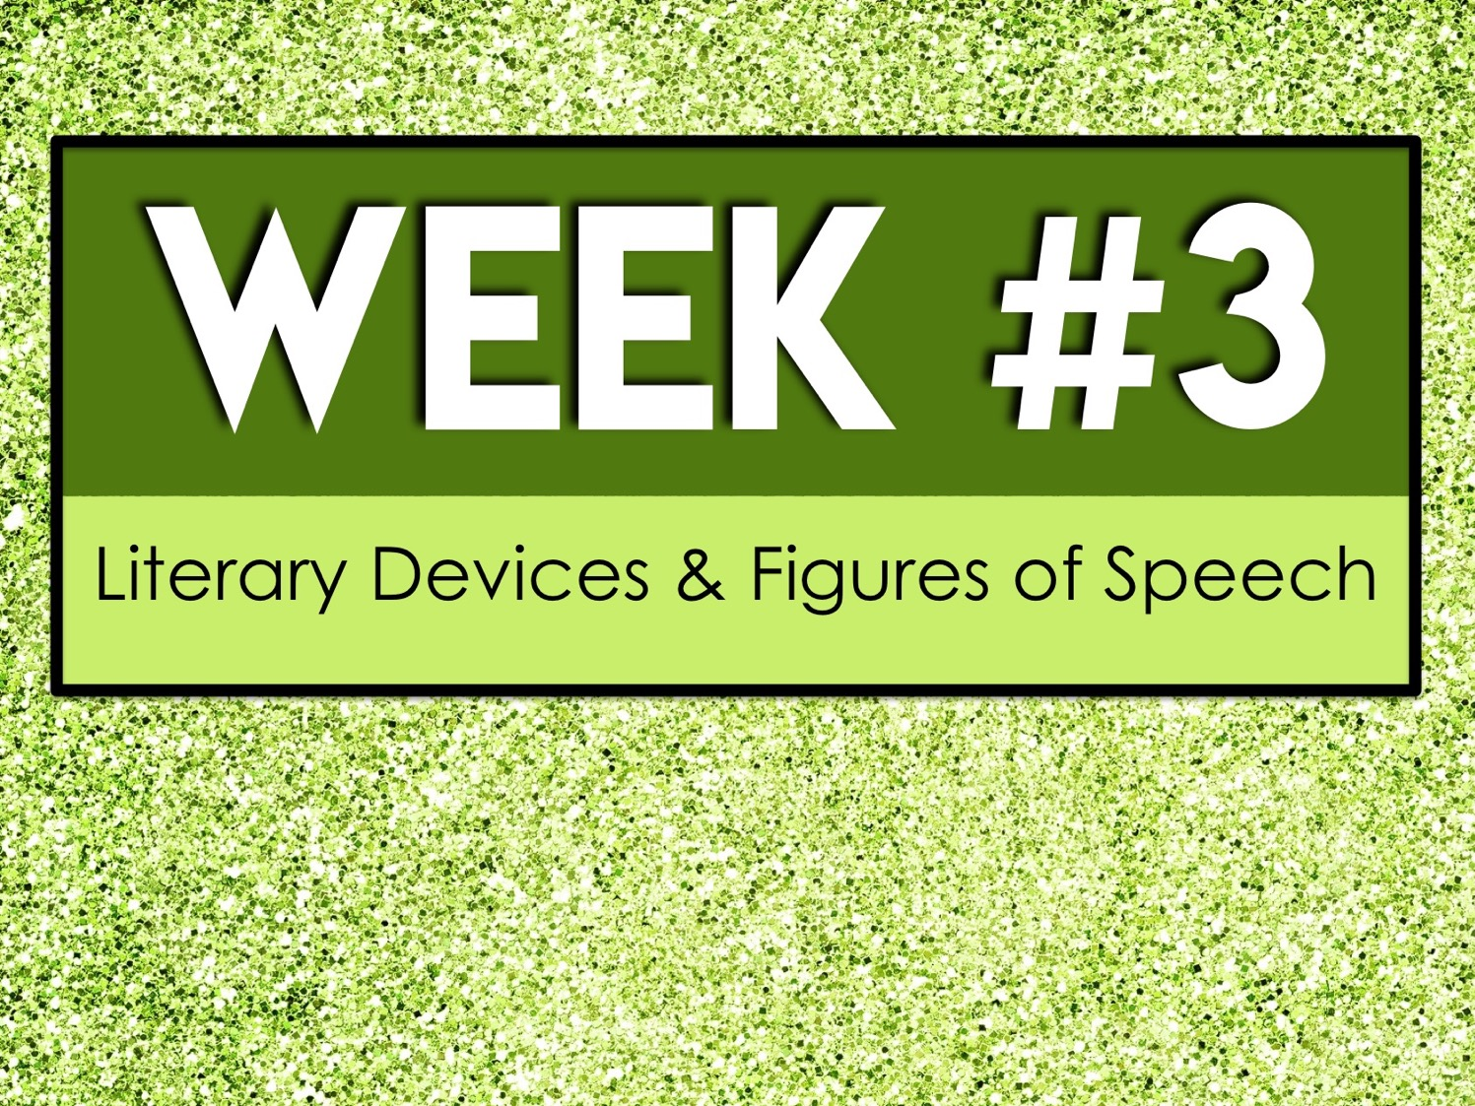
Week #3
Literary Devices & Figures of Speech

Slide 30
Week #3 Words
Hubris
Hyperbole
Idiom
Imagery
Metaphor

Slide 31
Week #3 Pretest
DIRECTIONS: In your own words, try your best to define each term.
Hubris
Hyperbole
Idiom
Imagery
Metaphor

Slide 32
Hubris
excessive pride or self-confidence

Slide 33
Hyperbole
exaggerated statements or claims not meant to be taken literally

Slide 34
Idiom
a group of words established by usage as having a meaning not deducible from those of the individual words

Slide 35
Imagery
visually descriptive or figurative language, especially in a literary work

Slide 36
Metaphor
a figure of speech in which a word or phrase is applied to an object or action to which it is not literally applicable

Slide 37
Week #4
Literary Devices & Figures of Speech

Slide 38
Week #4 Words
Motif
Oxymoron
Paradox
Personification
Pun

Slide 39
Week #4 Pretest
DIRECTIONS: In your own words, try your best to define each term.
Motif
Oxymoron
Paradox
Personification
Pun

Slide 40
Motif
a distinctive feature or dominant idea in an artistic or literary composition that may contribute to the theme

Slide 41
Oxymoron
a figure of speech in which apparently contradictory terms appear in conjunction

Slide 42
Paradox
a seemingly absurd or self-contradictory statement or proposition that when investigated or explained may prove to be well founded or true

Slide 43
Personification
the attribution of a personal nature or human characteristics to something nonhuman, or the representation of an abstract quality in human form

Slide 44
Pun
a joke exploiting the different possible meanings of a word or the fact that there are words that sound alike but have different meanings

Slide 45
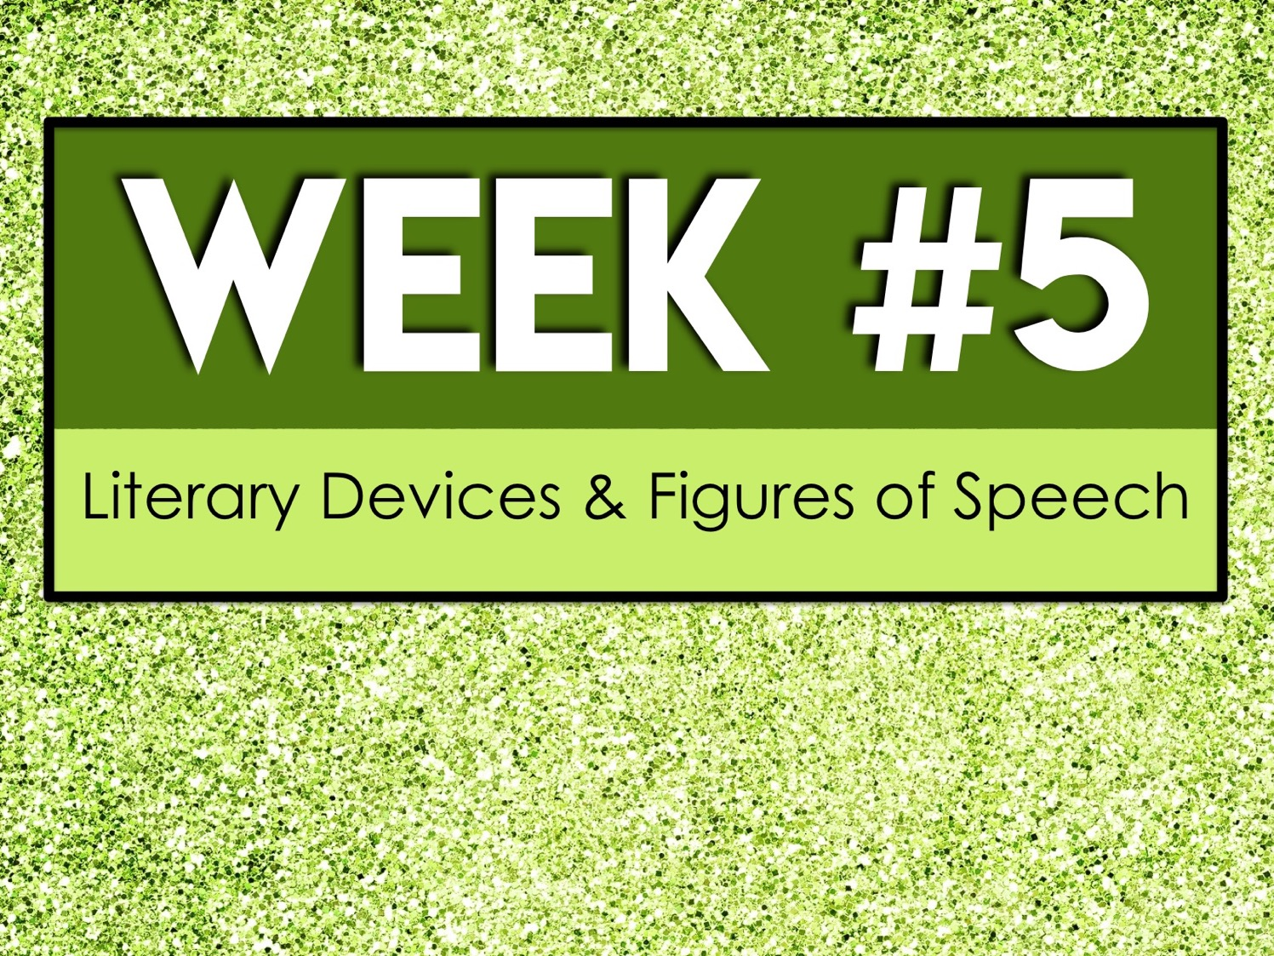
Week #5
Literary Devices & Figures of Speech

Slide 46
Week #5 Words
Simile
Situational irony
Suspense
Symbol
Verbal irony

Slide 47
Week #5 Pretest
DIRECTIONS: In your own words, try your best to define each term.
Simile
Situational irony
Suspense
Symbol
Verbal irony

Slide 48
Simile
a figure of speech that makes a comparison, showing similarities between two different things using the words like or as

Slide 49
Situational irony
irony involving a situation in which actions have an effect that is opposite from what was intended, so that the outcome is contrary to what was expected

Slide 50
Suspense
a state or feeling of excited or anxious uncertainty about what may happen

Slide 51
Symbol
a thing that represents or stands for something else, especially a material object representing something abstract

Slide 52
Verbal irony
irony in which a person says or writes one thing and means another, or uses words to convey a meaning that is the opposite of the literal meaning

